Slide 1


LA Clippers Business Insights -
Predicting attendance at the
2018/2019 regular season games

Slide 2

Index
Topic | Page Number
Insights from Excel Analytics | 3
Key Findings from R code | 4
Process Walk-through | 5
Next Steps | 6
Code Walk-through | 7 - 13

Slide 3
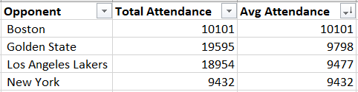


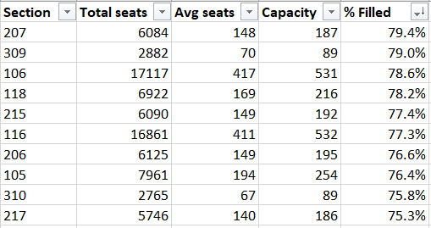

Key Insights from Analytics in Excel
Opponents with top average attendance
Weekend games have higher avg attendance
Low Correlation between vegas odds and attendance
Sections with top filled capacity
Higher avg attendance before start of game

Slide 4
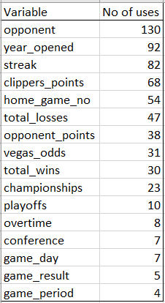
Key Findings from R code
High
Medium
Low

Slide 5
Process Walkthrough
Step | Description | Tools Used
Data cleanup + Analytics on Excel | Organizing Game, Team and Attendance (Ticket Scan) data by game into 1 table + Formatting | Excel
Read cleaned data from Excel | Read cleaned data into R and create factor variables for text columns | R
Data partition into Train and Test data | Partition data into Train (70%) and Test (30%) datasets | R
Construct Random Forest Model | Regress Attendance per game on all variables with ntree = 100 and mtry = 6 (1/3 of no of variables) | R
Prediction using RF model | Create prediction datasets for Train and Test using RF model | R
Error checking | Plot errors to determine ntree + Calculate Root Mean Square Error (RMSE) and Rsquare (R²) | R
Variable analysis | Plot variable importance by %IncMSE and IncNodePurity | R
Fine Tuning | Next step – modify mtry for optimal correlation and strength | R

Slide 6
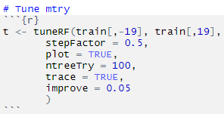
Next Steps – Fine Tuning
Two parameters are important in the random forest algorithm -
Number of trees used in the forest (ntree)
Number of random variables used in each tree (mtry)
default value - total number of all predictors divided by 3
only adjustable parameter to which random forests is sensitive
Code Snippet
Tuning Parameter - number of covariates to try at each split
Procedure
Set mtry to default value (1/3rd of total number of all predictors) and search for optimal ntree value
Changing mtry changes the correlation and strength proportionally - optimal range of mtry
Build 10 RF classifiers with different ntree values and record OOB error rate
See number of trees where OOB error rate stabilizes and reaches minimum – this is the optimal mtry

Slide 7
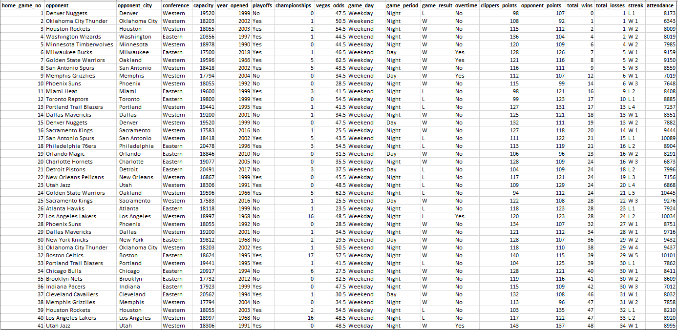
Code Walkthrough – Data Cleanup

Slide 8
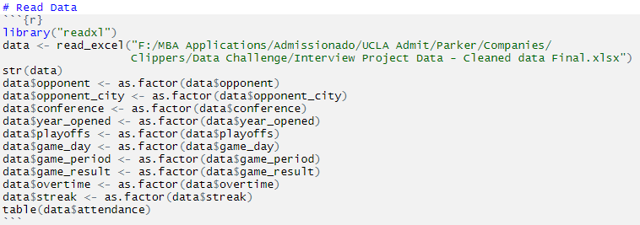

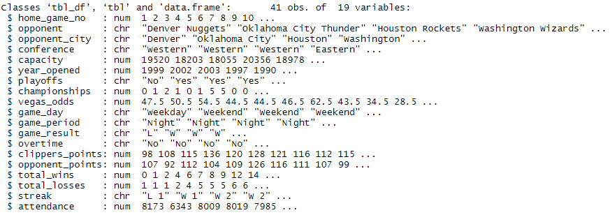
Code Walkthrough – Reading Data
Code
Environment Variables
Output

Slide 9
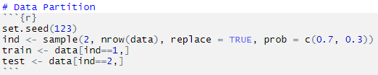
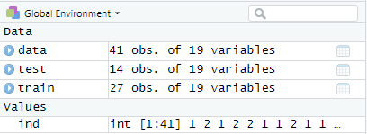
Code Walkthrough – Data Partition
Code
Environment Variables

Slide 10
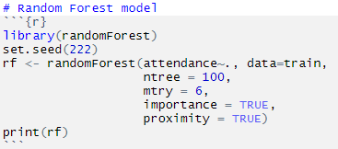
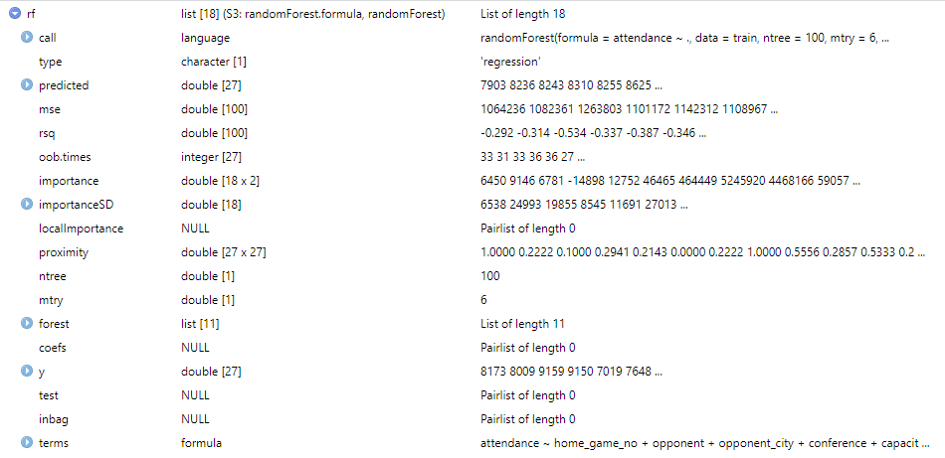
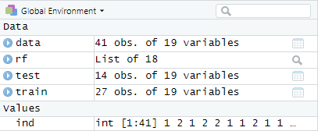
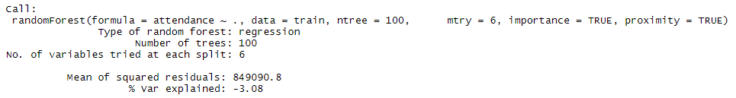
Code Walkthrough – Construct RF Model
Code
Model Description
Environment Variables
Output

Slide 11
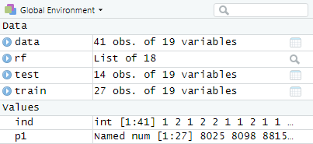

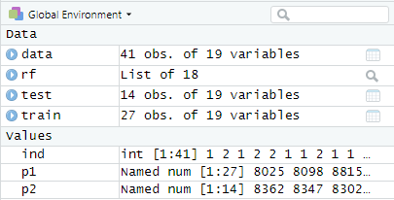

Code Walkthrough – Prediction
Environment Variables
Prediction on Training Data
Code
Output
Prediction on Testing Data
Environment Variables
Code
Output

Slide 12
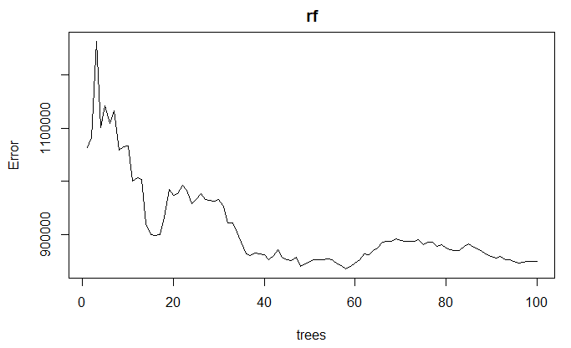

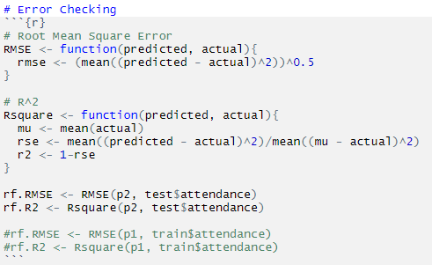
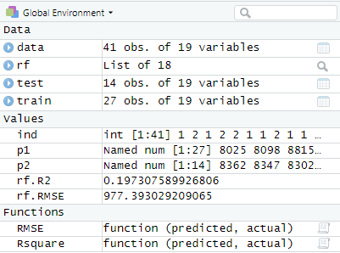
Code Walkthrough – Error Checking
Error Plot
Code
Code
Environment Variables

Slide 13
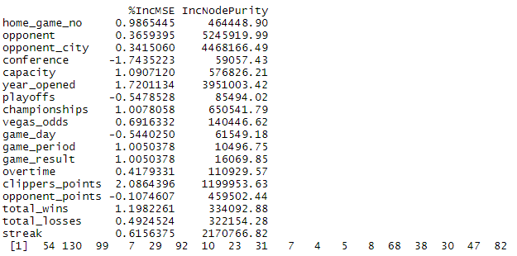
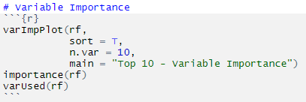
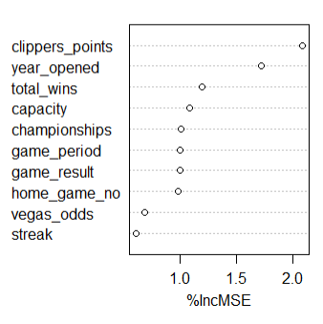
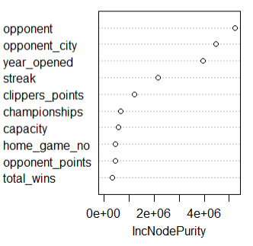
Code Walkthrough – Variable Analysis
Output
Code
Variable Importance Graphs
MeanDecreaseAccuracy - how much removing each variable reduces the accuracy of the model
MeanDecreaseGini - total decrease in node impurities from splitting on the variable, averaged over all trees

Slide 14


